Slide 1
E. coli and Hinkson Creek
Lynn Milberg
Water Quality Monitoring Section
Environmental Services Program
Trish Rielly
Monitoring and Assessment Unit
Water Protection Program

Slide 2
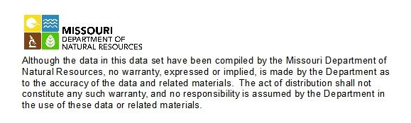

Slide 3
Overview
Why analyze for E. coli?
Hinkson Creek facts
How are the E. coli results assessed?
What does the future hold?

Slide 4
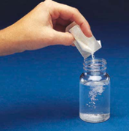

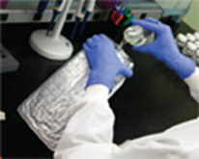

E. coli is a good indicator bacteria because it is:
Absent or in low concentrations in uncontaminated waters
Present when pathogens are present
Present in higher numbers than pathogens in contaminated water
Survives longer in the environment than pathogens
Easy and safe to analyze
Rapid results
Inexpensive
Accurate

Slide 5

10 CSR 20-7—DEPARTMENT OF NATURAL RESOURCES Division 20—Clean Water Commission
Hinkson has two stream reaches
  Upstream of Providence (Hwy 163) – WBID 1008, 18.8 miles long
  From Providence to the mouth – WBID 1007, 7.6 miles long
Classification
  WBID 1008 – Class C, whole body contact A (WBC-A)
  WBID 1007 – Class P, whole body contact B (WBC-B)

Slide 6
How is a stream judged to be impaired?
Assessments are conducted every two years
Assessment rules are spelled out in the Methodology for the Development of the Section 303(d) List in Missouri
A water is judged to be impaired if the geometric mean exceeds the standard in any of the last three years for which adequate data is available.
  Geometric mean is defined as at least five samples collected during the recreational season of April 1 – October 31, of any given year.
  WBC – A: 126 col/100 mL
WBC – B: 206 col/100 mL

Slide 7
What is the current status of the Hinkson Creek regarding bacteria?
Original assessments were conducted on bacteria data collected during the DNR Hinkson Creek studies conducted between 2003 and 2006
Once a stream is listed as impaired, it will be re-assessed with each assessment cycle
Hinkson was re-assessed in 2014, however new data were not available at the time the assessment began. This resulted in an unchanged status.

Slide 8
What’s next?
Updates for the 2016 assessment:
  Reclassification of WBID 1008 to WBC-A has been approved and will be applied
  New E.coli data are available for both WBID segments

Slide 9
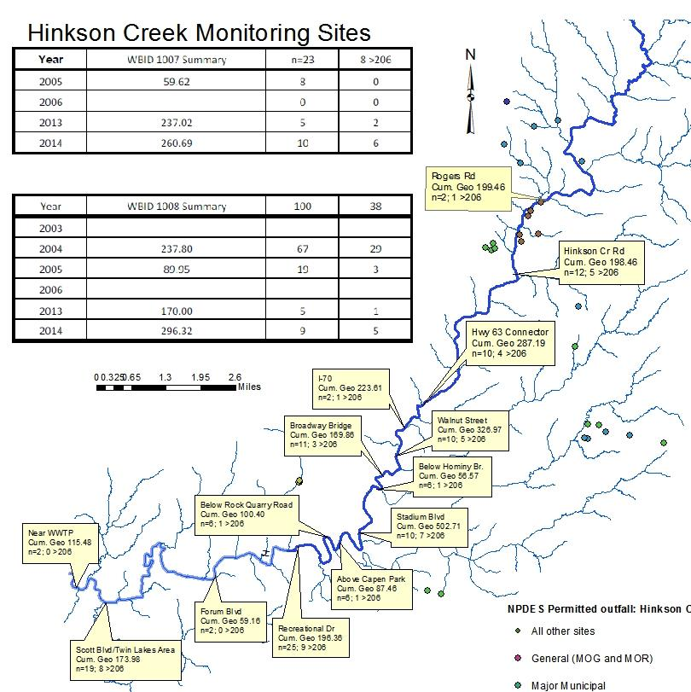
Preliminary data
Preliminary data

Slide 11
What must happen for Hinkson to be removed from the 303(d) list?

